Slide 1
UW-Madison
Data Governance/
Reporting & Analytics
Information Session
01/12/2018 - Ingraham
01/16/2018 - Union South
01/17/2018 - Gordon Commons

Slide 2
Agenda
Introductions
Purpose
Business Intelligence/Initiatives
Data Governance
Reporting & Analytics
Data.wisc.edu
Next Steps
Discussion
Notes:
First 3 slides align with the presentation we provided to the AC back in 2015 / 2016. Speak to the what we are trying to accomplish and the state that existed / still exists around BI here

Slide 3
Purpose
Provide overview of the past, current and future of Reporting and Analytics on campus, including addressing Query Library retirement
Understand how the Data Governance Program drives how we will implement Business Intelligence at UW-Madison
Notes:
First 3 slides align with the presentation we provided to the AC back in 2015 / 2016. Speak to the what we are trying to accomplish and the state that existed / still exists around BI here

Slide 4
Business Intelligence
Institutional Data – an Institutional Asset
Business Intelligence: putting data to work for operations, analysis, decision-support and progress on strategic goals
Data Governance: curation to support access, security, quality , consistency, literacy
Notes:
First 3 slides align with the presentation we provided to the AC back in 2015 / 2016. Speak to the what we are trying to accomplish and the state that existed / still exists around BI here

Slide 5
Data On Your Own
Data for Everyone
Robust institutional data creation systems
Centers of skill in reporting, analysis
Connectivity and coordination in pockets
Good access for cognoscenti
Weakness in connectivity, planning
Weakness in data literacy, training, documentation
Uneven access to useful reports, analysis
Robust institutional data creation systems
Robust data warehouse structures
Centers of skill in reporting, analysis
Connectivity and coordination
Systematic decisions and processes for report delivery
Stronger planning for reporting needs, data to support operations
Coordinated training, documentation

Slide 6
Why Data Governance?
Data are an institutional asset
What if our data were suddenly not available, reliable or secure
Data Governance is a programmatic approach to defining the responsibilities of managing data and assigning those responsibilities to the appropriate resources
Data Governance should enable effective data-driven decision-making
Enable Information Literacy

Slide 7
Program Goals
Establish a 'data-quality' culture that drives data informed decision making
Create Structured Accountability, with defined roles and responsibilities
Facilitate Collaboration & Education related to data-related policies and use of data
Facilitate standard, consistent definitions where appropriate
Align with campus shared governance

Slide 9
How do we improve BI @ UW-Madison
Distributed
Reports / Analyses developed and distributed from multiple departments on campus
Complex
Multiple data sources: institutional, local, third-party
Data sources in applications not controlled by UW-Madison: SFS, HRS, LMS, AEFIS, etc.
Varied users with different skill sets
Notes:
Next four slides more in-depth to what we thought about from a requirements perspective as to why we are heading the direction we are with the project and the BI landscape overall

Slide 10
BI at UW-Madison
Until 2016, there was not a central, governed, verified repository of analytical content (i.e. reports, dashboard, institutional information) available for UW-Madison
No information validation
Duplicate queries / reports
Out-dated queries / reports
A person with access could distribute information to anyone on campus

Slide 11
Current BI Initiatives
Data Governance activities
Training on use of Restricted data
Formalizing stewardship of data domains
Implementing UW-Madison Data dictionary
UWRAP (UW Reporting & Analytics Project - Replacement of Hyperion / Interactive Reporting)
Tableau
Notes:
Multiple BI initiatives, the UWRAP project is just one. But it is important to note they all align together

Slide 12
UW-Madison Data Governance /
BI Program Structure
Institutional Leadership
Data Stewardship
Council
BI Program Leadership Team
Officially convened by Data Stewardship Council
Define & document officially sanctioned definitions
Project Core Team
Membership from APIR, RO/DEM, GS, OHR, a/c/depts, operational units, InfoAccess
Data / Metric Definitions Team
BI Community of Experts
Notes:
Project Structure

Slide 13
Types of BI Users at UW-Madison
End-Users
Non-technical people who receive reports developed by someone else.
They may download data as part of other business processes (i.e. creating mailings / email lists or student rosters)
Data may come from institutional sources (i.e. SFS, HRS, SIS) or it may come from local sources (i.e. OASIS).
Data may come from external sources (national benchmarking data)
Not a clear understanding of the data with which they are working
Many times do not understand the business processes that created the data

Slide 14
Types of BI Users at UW-Madison
Power Users / Analysts
Create their own queries.
May or may not know SQL
Have used Hyperion desktop to create their own queries.
Connect to a variety of data sources
May be responsible for delivering local information to their respective school / college / department

Slide 15
Types of BI Users at UW-Madison
Institutional Analysts
Create their own queries.
May or may not know SQL
Have used Hyperion desktop to create their own queries.
Connect to a variety of data sources
Are responsible for delivering institutional information to a wide variety of users / consumers
What role isn’t listed?
BI Developers

Slide 16
UWBI / UWRAP
Oracle is ending support of Hyperion / Interactive reporting in April of 2018
Each institution is responsible for migrating / re-purposing reports out of the ‘query library’ to a new environment
UW System administration is responsible for migrating / re-purposing queries that are shared by many institutions w/in the UW System (i.e. shared HR queries)
UW System administration has chosen to use Oracle’s suite of BI tools to do this (OBIEE)
Notes:
Make sure people hear there are actually two projects – UW-System and UW-Madison. Define scope of each

Slide 17
UWRAP
We are not migrating Hyperion queries (Interactive Reporting queries) to OBIEE in the short term
Not because of the tool, because of the time, resources and money it would take to implement effectively for our institution
HR content that is shared across UW-System will be delivered through OBIEE
HR content that is Madison only will be delivered through Tableau
Student content will be delivered through Tableau, the Data Center in SIS, and the Advising Gateway
Institutional financial content is being delivered today differently and will continue to be done so
Wrapping up a pilot for an ad-hoc query tool to replace Hyperion desktop. Recommendation will be forthcoming in the beginning of 2018
Notes:
Because of all the above – here’s where we are at today and where we are headed.

Slide 18
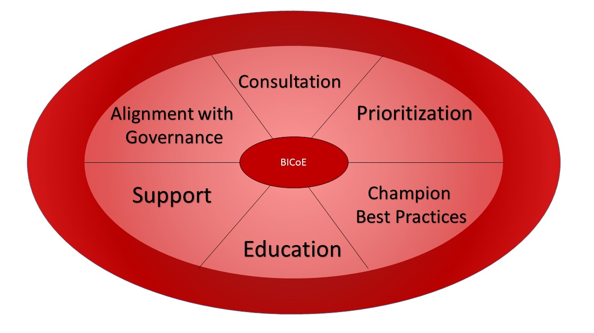
UWRAP Structure
Institutional Leadership: Sarah Mangelsdorf, Provost; Laurent Heller, VCFA
BI Executive Leads: Jason Fishbain, CDO; Jocelyn Milner, APIR
Tableau Environment Coordinator: McKinney Austin
UWRAP Project Manager: Patrick Hare
BI Program Leadership Team
-Leadership from major operations units/sites of internal data creation
- InfoAccess leadership
- Substantial overlap with Data Governance advisory group
BI Community of Experts
Expert analysts and data practitioners from operational units: APIR, Budget, RO, RSP, Bus Svcs, Libraries, FP&M, DEM, SMPH, Grad School, L&S
Notes:
Project Structure

Slide 19
Tableau
What is Tableau?
Interactive data visualization software
Developer:
Connects to data source, e.g. InfoAccess
Designs and builds charts, figures, tables
Adds interactivity—filters, parameters, options
Publishes to institutional server
User accesses through web browser
Notes:
Because of all the above – here’s where we are at today and where we are headed.

Slide 20
Tableau
What have we been doing with Tableau?
Have been growing the developer base, user base, and infrastructure
Already have development by APIR, RO, Enrollment Management, Grad School, Libraries, FP&M, Purchasing Services, Risk Management, RSP, Budget...and others interest
Notes:
A little context here: started small a few years ago with a couple of central administrative units. Have been growing developer base, user base, and infrastructure—process, standards, style, etc.

Slide 21
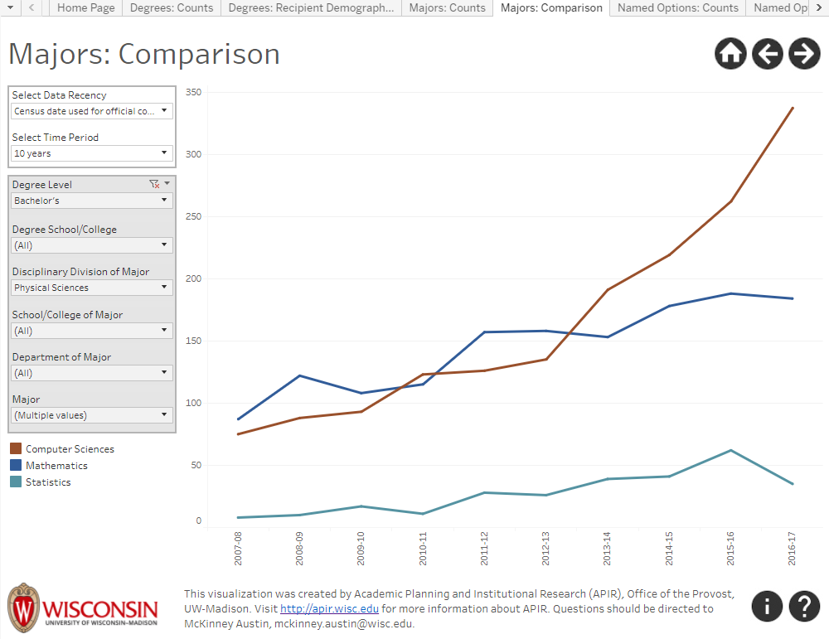
Notes:
A little context here: started small a few years ago with a couple of central administrative units. Have been growing developer base, user base, and infrastructure—process, standards, style, etc.

Slide 22
Tableau
What WILL we be doing with Tableau?
As part of UWRAP, we will use Tableau to provide access to the record-level data
Functionality and content will be similar to Query Library
These Tableau workbooks will be called Institutional Data Exporters
Notes:
Will continue development of visualizations, but will also be using Tableau to provide much of the record level data many currently get from the Query Library.

Slide 23
Notes:
Will continue development of visualizations, but will also be using Tableau to provide much of the record level data many currently get from the Query Library.

Slide 24
Finding, Accessing, Requesting
How will I be able to find what I'm looking for?
How will I know what is available?
How will I get access to what I need?
What if I need something that I can't find?
Notes:
These needs have all been identified and we are working on solutions. We expect to have a portal, or search engine, to find data and information on the data.wisc.edu website in the near future. We are reviewing options for how to authorize users and how to handle requests for unmet data needs.

Slide 25
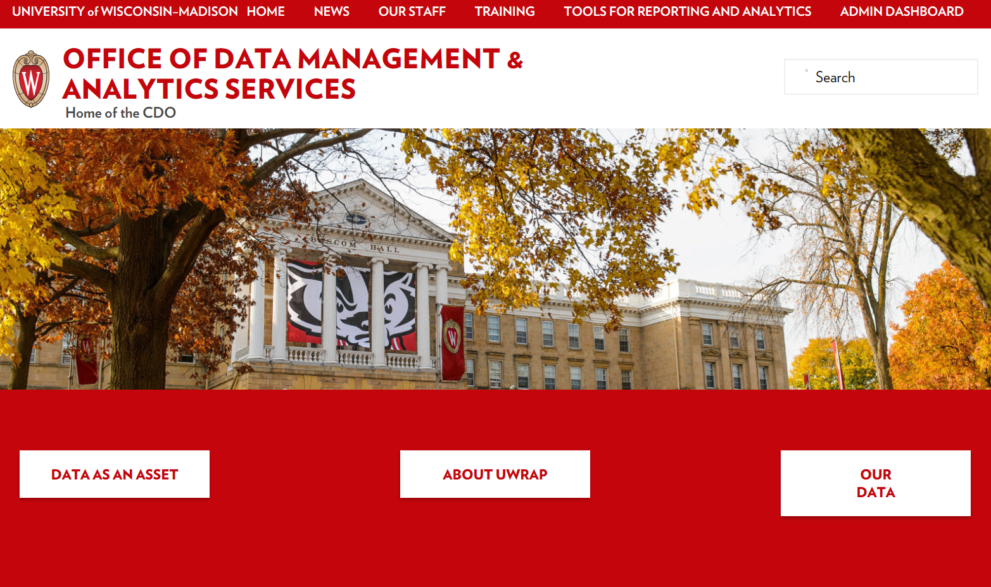
Data.wisc.edu
kmelland@wisc.edu
Notes:
For those of you who have not visited data.wisc.edu recently, there have been a few updates. We went with the new UW theme and really worked on a more user-friendly layout. Most of the content was moved directly from the original page, but you will notice more visuals and less text.
We wanted to use the rollout of this site to introduce the new Office of Data Management and Analytics Services. At the top of the page you will find a link to our staff page, where you can learn more about our staff and what they do. (I will navigate to page to show them.)
Training- This page is not yet available. We are currently in the process of creating a Restricted Administrative Data Access training. When we roll this out, you will be able to navigate to this page to access the training. When other trainings are created, they will also be available here. (I will navigate to page to show them.)
News- We will keep our page updated with upcoming events. More info sessions will be scheduled at a later date. You can visit this page to find whether they are of any interest to you. (I will navigate to page to show them.)
Thank you for your time today and if you have any feedback on the new webpage, please feel free to email me at kmelland@wisc.edu.

Slide 26
NEXT STEPS?
Informational sessions starting Jan 2018
More targeted sessions Feb – April targeting specific subject areas (i.e. Degree Awards, Student Demographics, HR/Payroll)
Recommendation on purchase of ad-hoc query tool
De-commissioning of Query Library starting in April 2018
See http://data.wisc.edu for more information

Slide 27
Discussion

